Slide 1
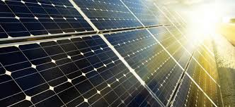
GNR COURSE PROJECT
Short-term solar power prediction using a support vector machine

Slide 2


Shaun Zacharia
180110073
Contribution: Brainstorming the idea and its relevance to the theme of the course. Divided tasks amongst the other team members and drew up the workflow of the project. Partly coded the Neural Network and the SVM implementation.
Harshit Shrivastava
18D070011
Contribution: Generated all the required plots and performed the literature survey for procedure to be followed.
Team Members and Contributions

Slide 3



Bhavika Ranjeet Kumar
18D070042
Contribution: Partly preprocess the data and ensured collaboration in the team.
Nakul Randad
Contribution: Partly coded the Neural Network and SVM implementation.
Shreshtha Singh
18D070029
Contribution: Partly preprocessed the data and obtained the dataset.
Team Members and Contributions

Slide 4
Problem Definition
The aim of the project is to test the implementation of a model which predicts Irradiation falling on the ground for different prediction horizons using an SVM (Support Vector Machine) and its comparison with the current hype (neural networks).

Slide 5
Method

Slide 6
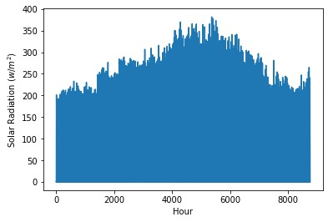
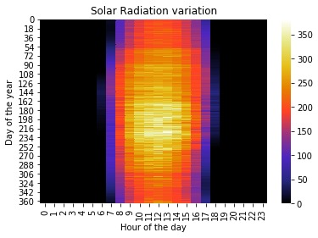
Preprocessing
The proposed model has used a 2D representation for hourly solar radiation, which gives more insight into the solar radiation pattern than the regular 1D representation.
The solar radiation values are close to zero from 8 pm to 6 am of the next day because there is no sunlight at night.

Slide 7

c. Normalization
The data was normalized using sigmoid normalization, as suggested in the paper since it gives better results for our purposes.
The equation to the left shows the normalization formula used for each row in the input data.

Slide 8
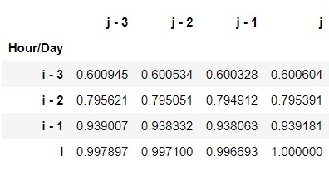
AutoCorrelation Matrix
In this table, i denotes an hour in a day and j denotes a day in a year.
The value in cell (i 2, j 3) represents the autocorrelation coefficient between the latest solar radiation data and the data obtained 3 days and 2 h (i.e., 74 h) ago
An important observation is that there are strong correlations between the radiations in consecutive days for the same hour compared to same day, consecutive hours.

Slide 9
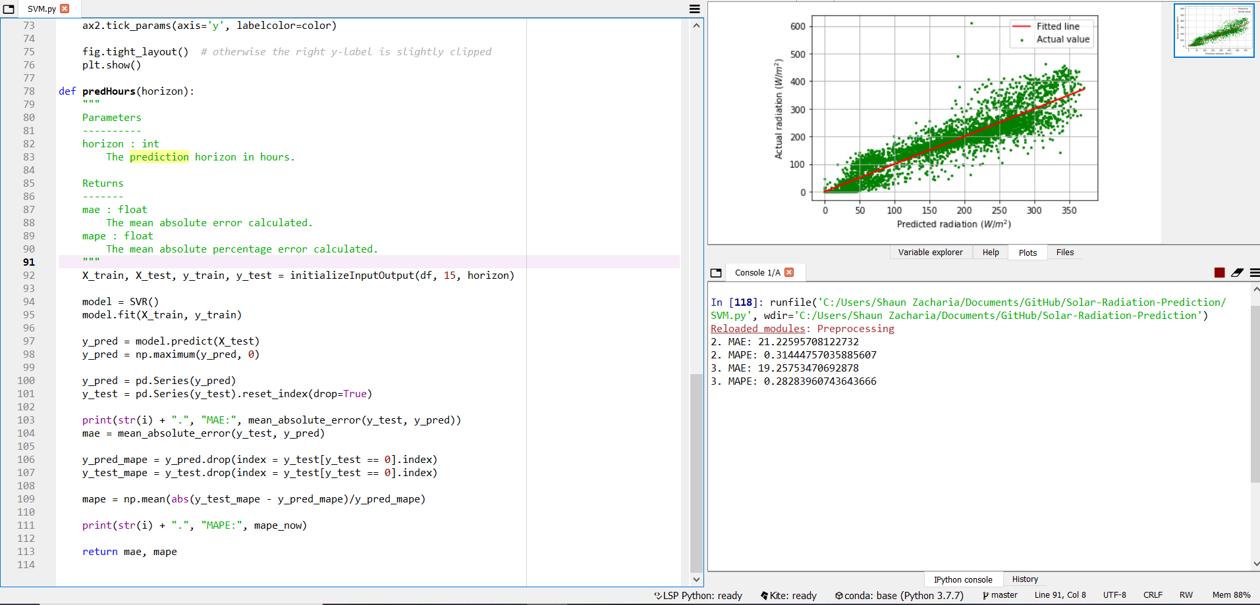
SVM Implementation
Because of the insights we got from the autocorrelation table, and the suggestions in the paper, we decided to set the input data as the latest weather conditions, and the irradiation of the previous day at the same hour. The SVM uses an RBF kernel, as that was suggested in the paper.
Screenshot of running code

Slide 10
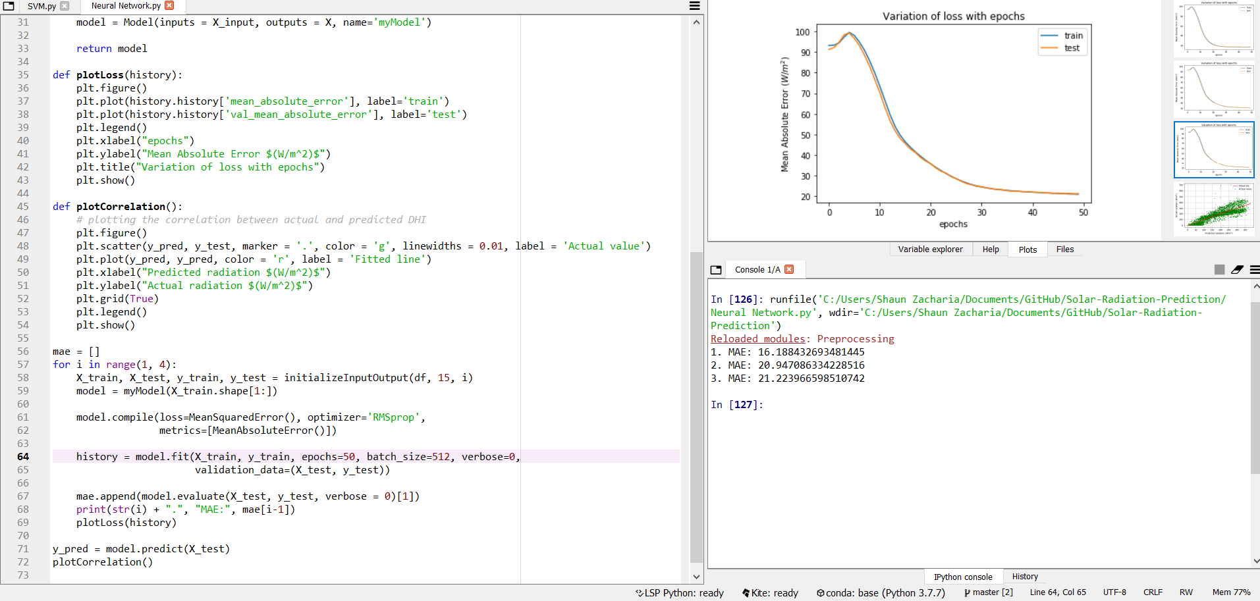
Neural Network Implementation
Even for the Neural Network, we used the same input and output data for training and testing, an architecture containing 3 layers was used with ReLU activation layers. We simply used MLP without any other features.
Screenshot of running code

Slide 11
Results

Slide 12
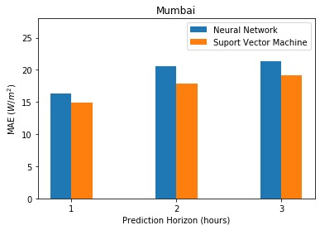
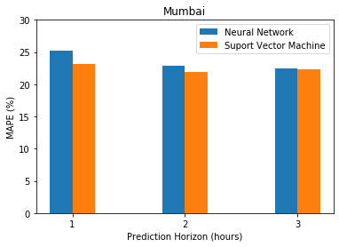
Results - Effectiveness Analysis
The graphs show the MAE(W/m²) and MAPE(%) comparison of SVM and Neural Nets for different prediction horizons. Clearly the SVM-based model clearly achieved a better performance than the NN model in every one of them.

Slide 13
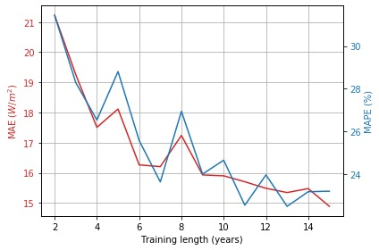
Result - MAE & MAPE
Here, we can see the relation of MAE (mean average error) and MAPE (mean average percentage error) with the training size (in years). Naturally, as training size increases, the MAE and MAPE decreases (at least the general trend). Although, as the training data increased, so did the time for training, the whole SVM code takes around 1 hour to get the results after training for every combination of years to get this data.

Slide 14
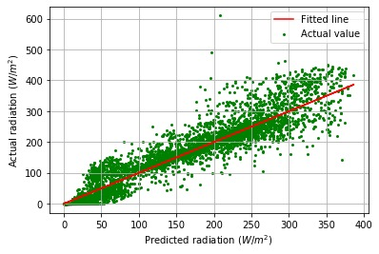
Actual VS Predicted radiation (SVM)
Here, we can see the spread of predictions and actual data. The actual values were scatter plotted against the predicted ones and this is what we obtained.
This gives us a visual representation of how well the model is behaving, the wider the spread of the scatterplot, the worse it is in predictions.

Slide 15
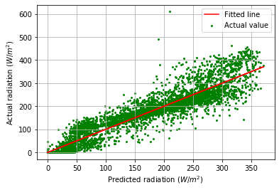
Actual VS Predicted radiation (NN)
We can see that the spread of the plot generated by the Neural Network is slightly wider than that of the SVM, a fact supported by the lower values of MAE and MAPE obtained by the model.
We chose comparison against a neural network to show the performance of the SVM based model against the current “hype” in machine learning, i.e. deep learning and saw the SVM perform better :)

Slide 16
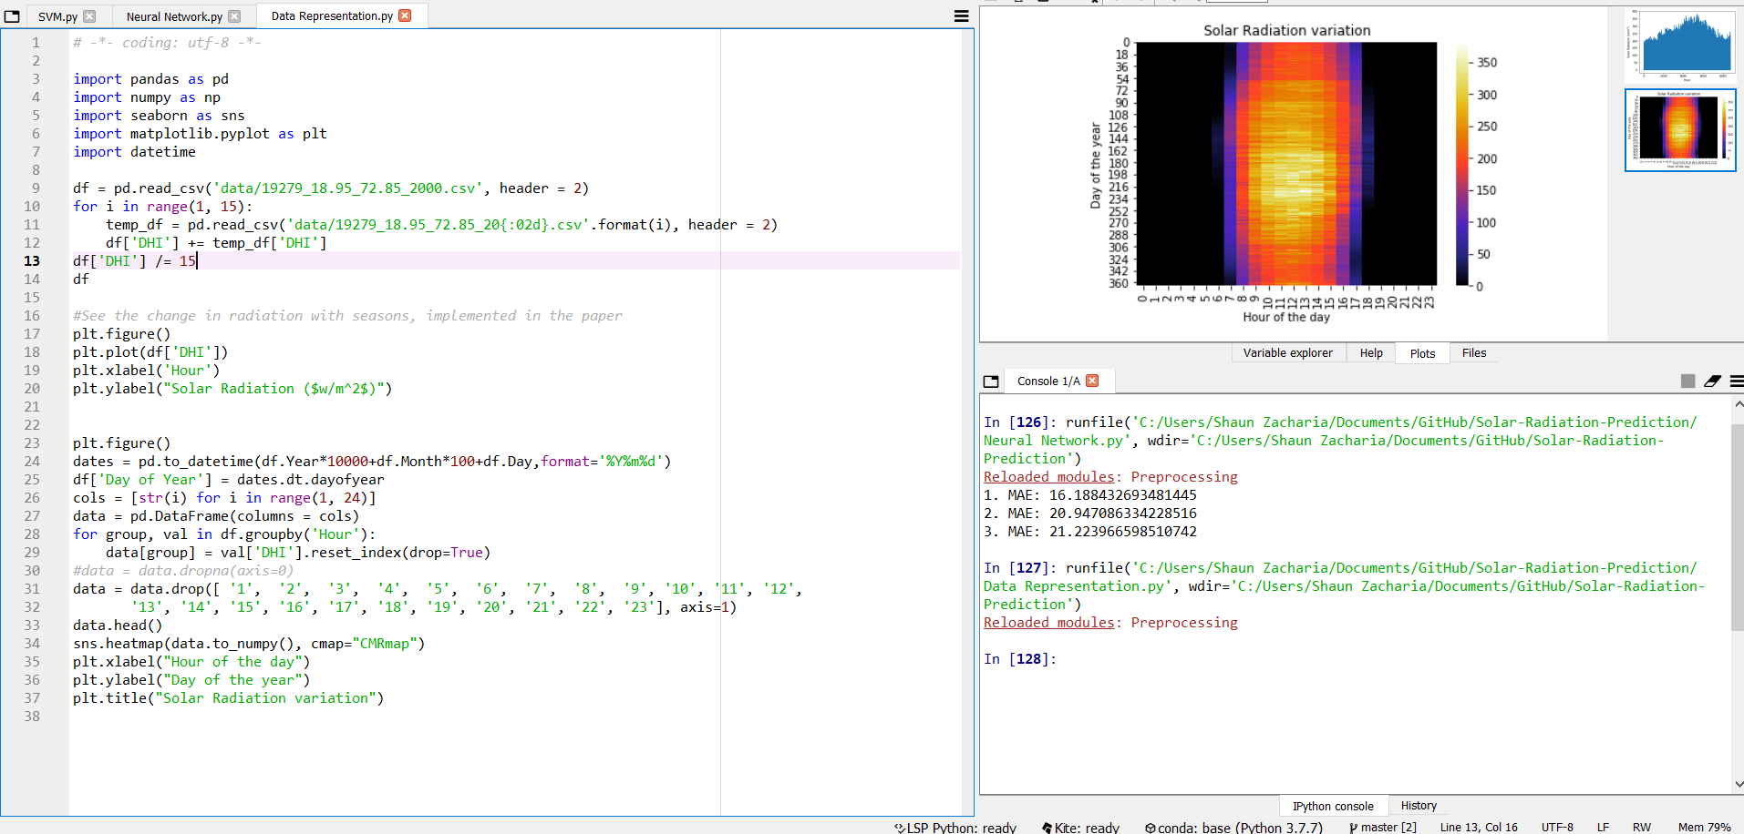
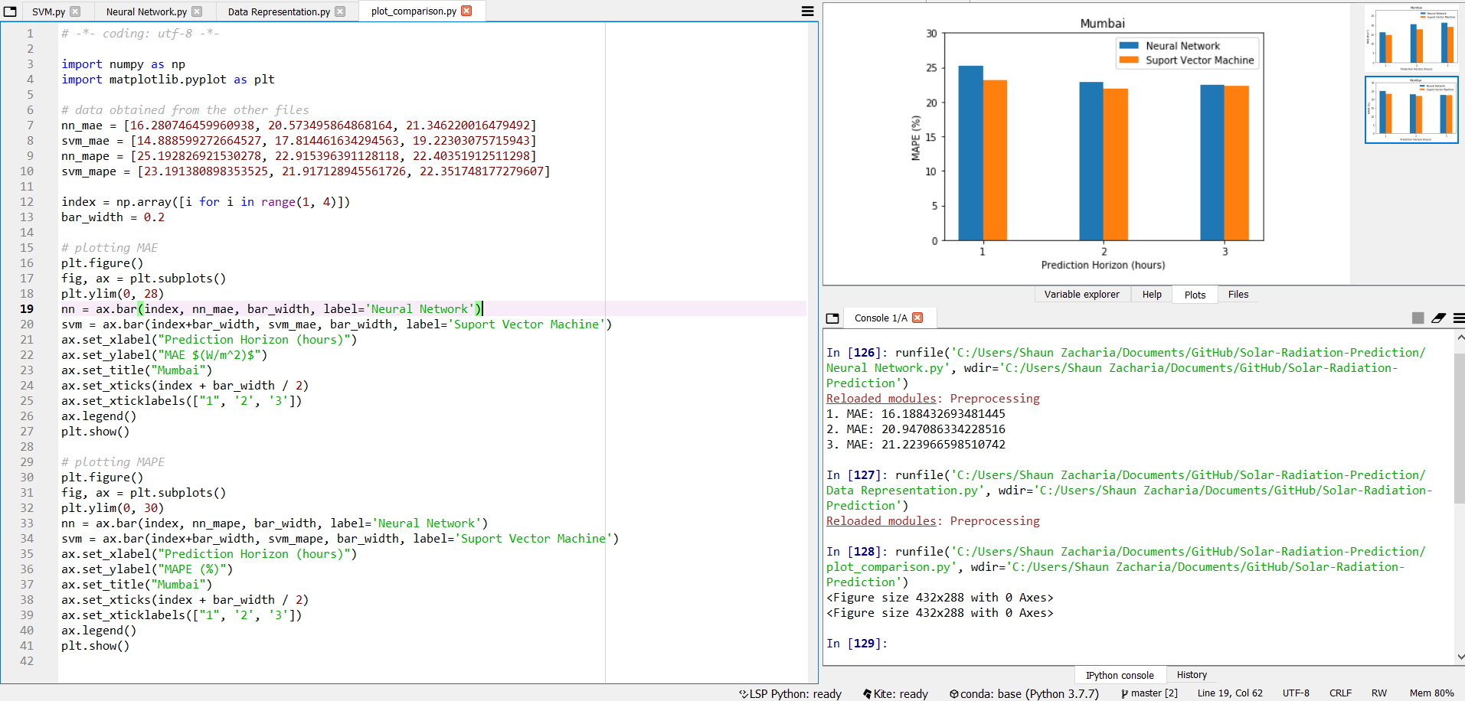
Other Running Code Screenshots

Slide 17
Conclusion
We tested the SVM model against the other model and found it to be superior in all prediction windows. The task of implementing an actual paper was a new and exciting experience for us and was thoroughly enjoyed by all for us. We also learned how to remotely collaborate amongst ourselves, an invaluable lesson. The insights we got while implementing the research paper were vital and we sincerely thank Prof. Biplab Banerjee for providing us with an opportunity to collaborate and learn from such a project.

Slide 18
References
Olatomiwa, Lanre, et al. "A support vector machine–firefly algorithm-based model for global solar radiation prediction." Solar Energy 115 (2015): 632-644.
Meenal, R., and A. Immanuel Selvakumar. "Assessment of SVM, empirical and ANN based solar radiation prediction models with most influencing input parameters." Renewable Energy 121 (2018): 324-343.
Zeng, Jianwu, and Wei Qiao. "Short-term solar power prediction using a support vector machine." Renewable Energy 52 (2013): 118-127.
Data collected from NSRDB database for Mumbai for years 2000-2015

